Slide 2

Ypp 4
bbv Software Services AG | Date

Slide 3




Bill of materials (BOMs)
| Date 28/08/2025

Slide 4
Agenda
Introduction
UI/UX Analysis
Use Case Diagram

Slide 5
BOMs
The bill of materials (BOMs) shows you exactly which components are part of a build, and whether any other assemblies share the same components.
It define:
The finished good (final product).
The materials/components required to produce that product.
The quantities of each material.

Slide 6
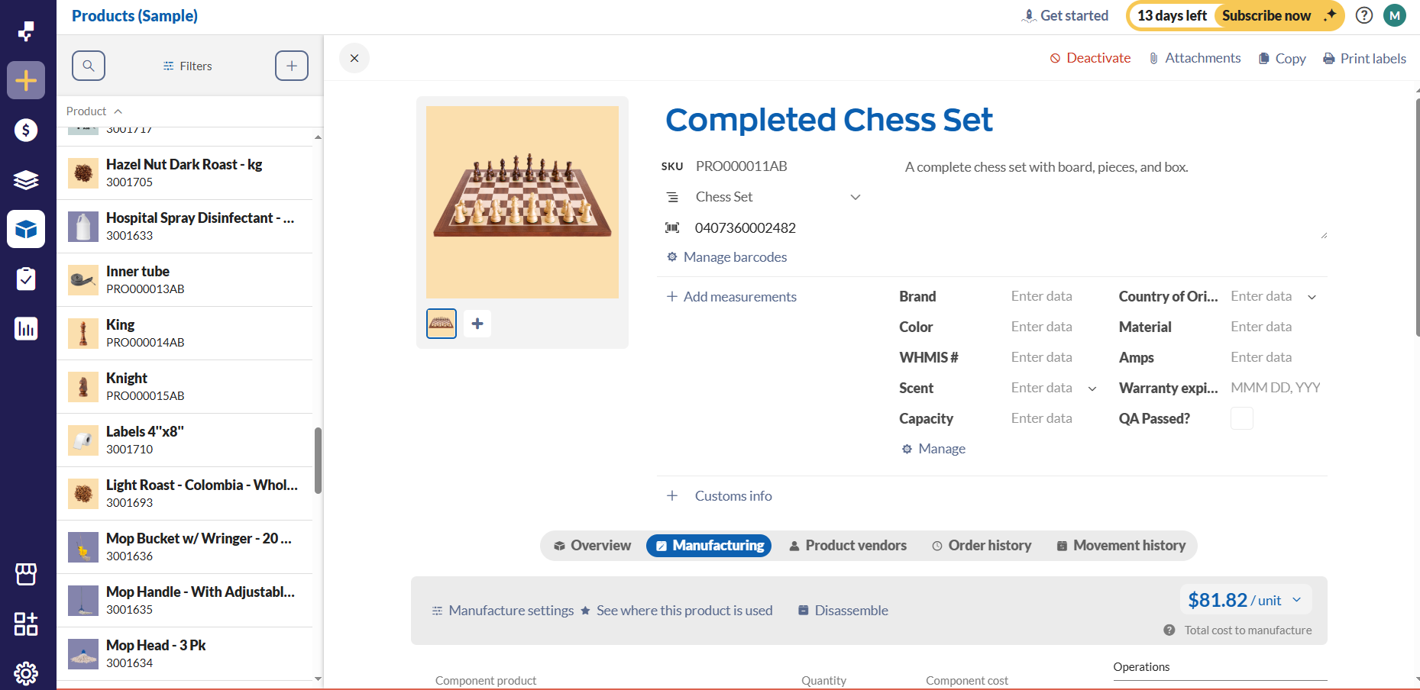
BOM Management

Slide 7
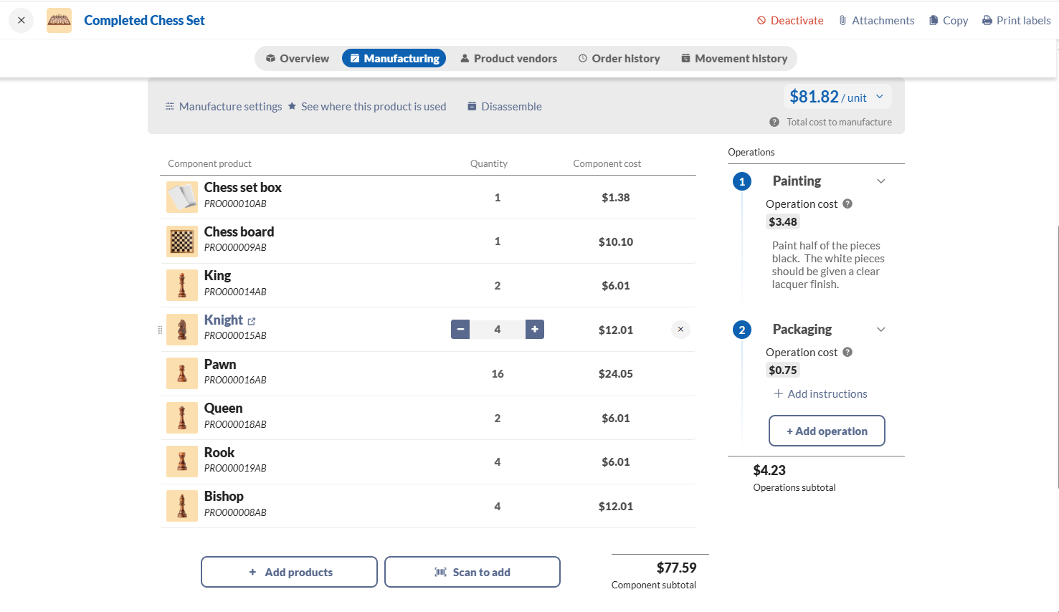
COSTS
BOM
OPERATIONS

Slide 8
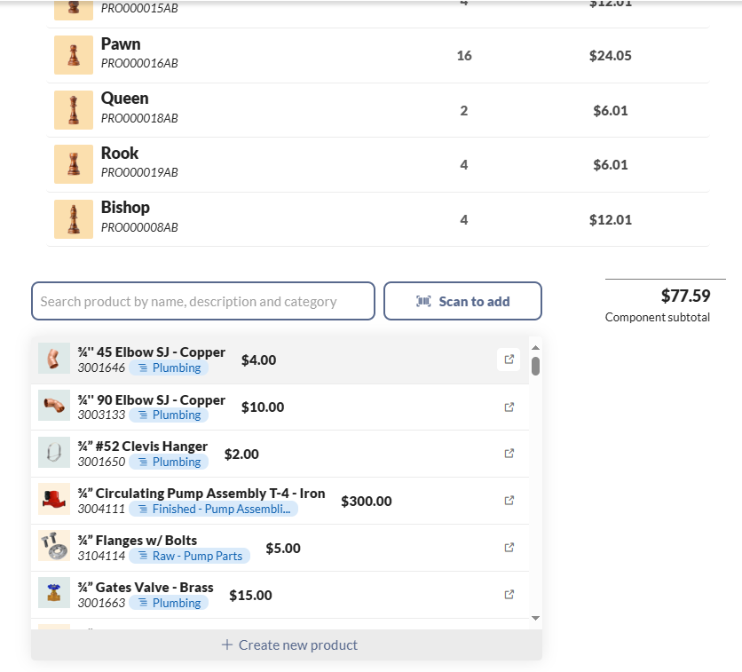
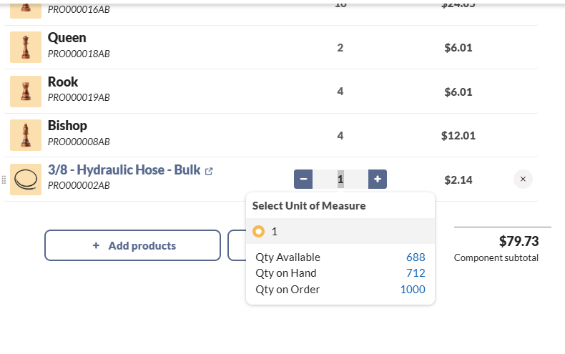
Add A New Product Recipe

Slide 9
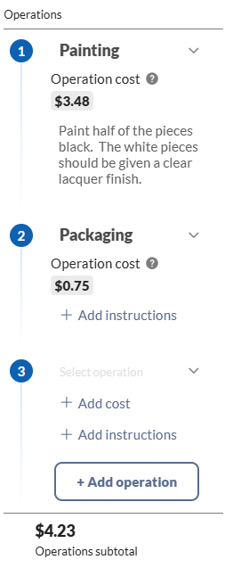
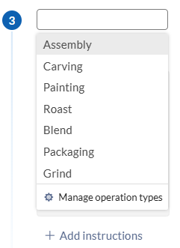
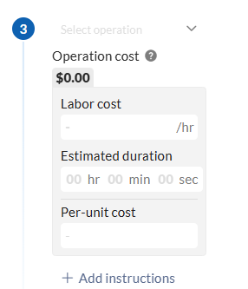
Add Operations
Select operation
Add Cost

Slide 10
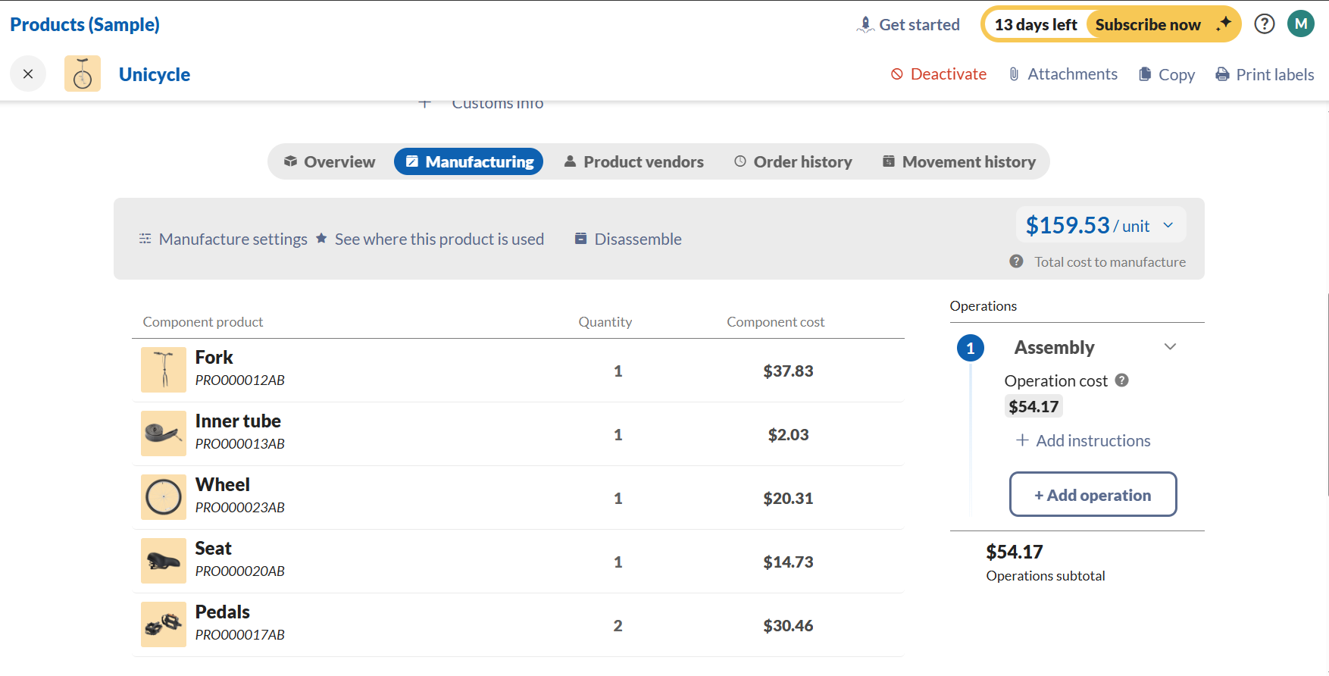
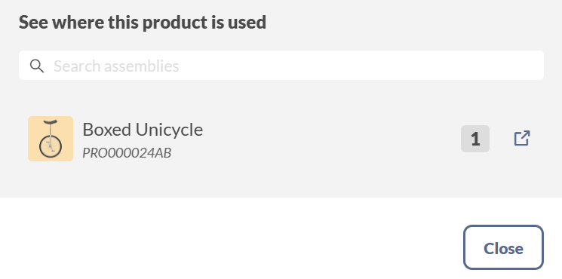
Track Component Usage

Slide 11
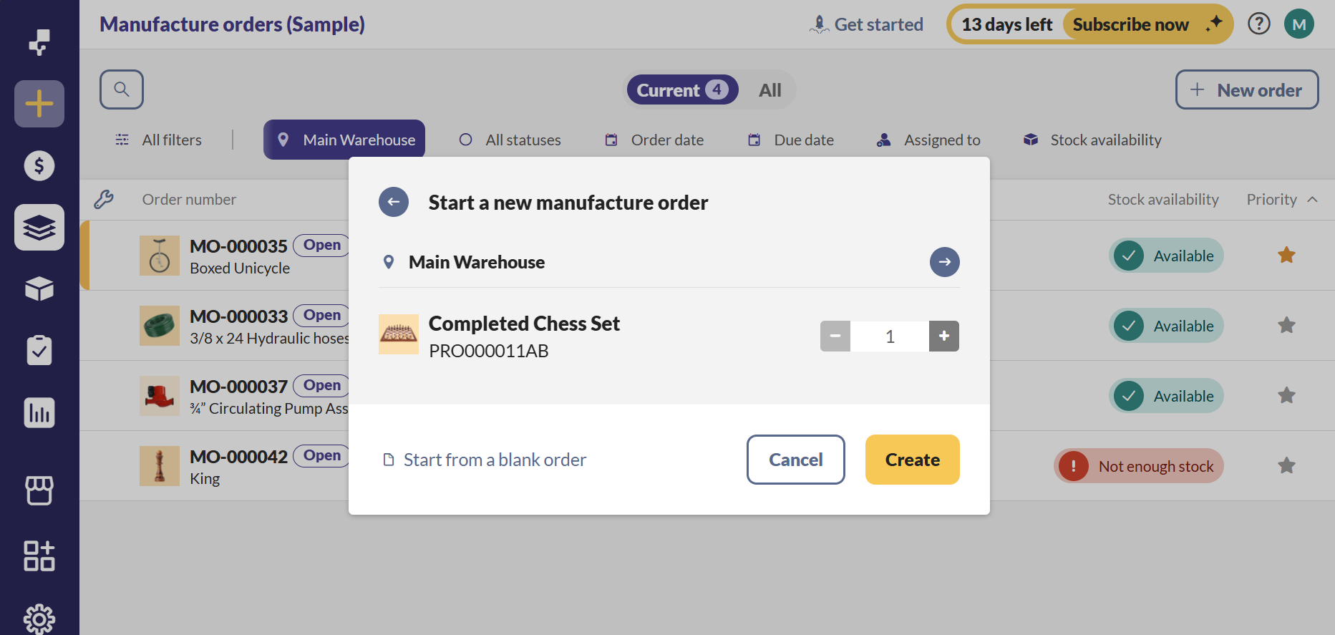
Integration with Manufacture Orders (MOs)

Slide 12
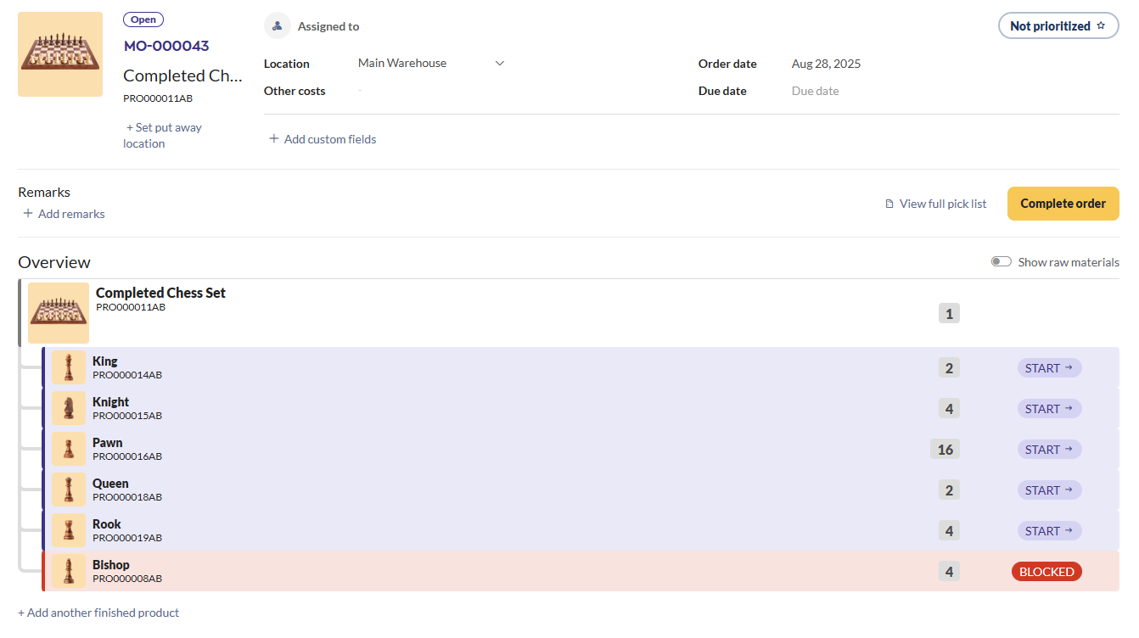
Integration with Manufacture Orders (MOs)

Slide 13
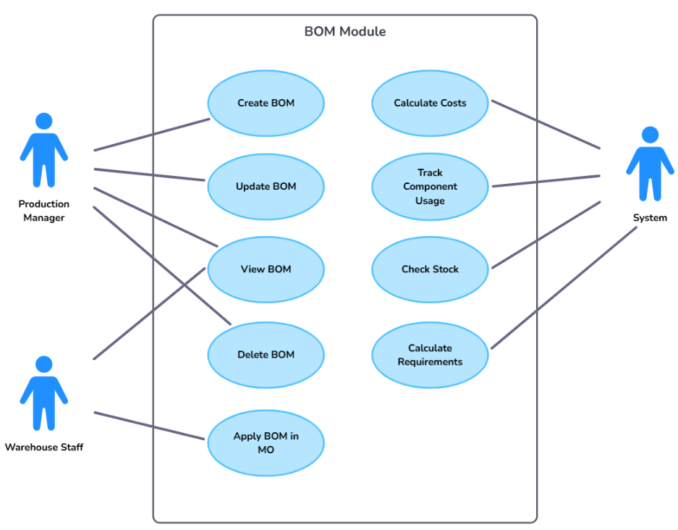
USE CASE DIAGRAM

